Slide 1

Supercharger Installation Guide
Internal using only And for Demo version
Confidential !

Slide 2
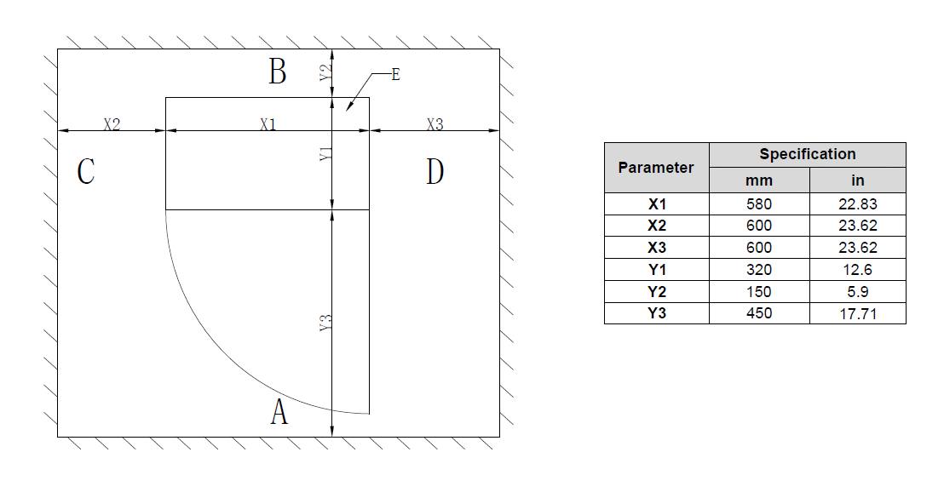
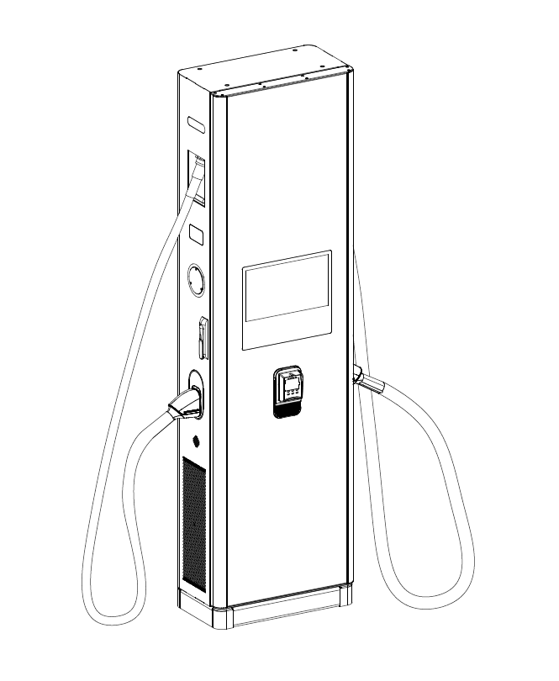
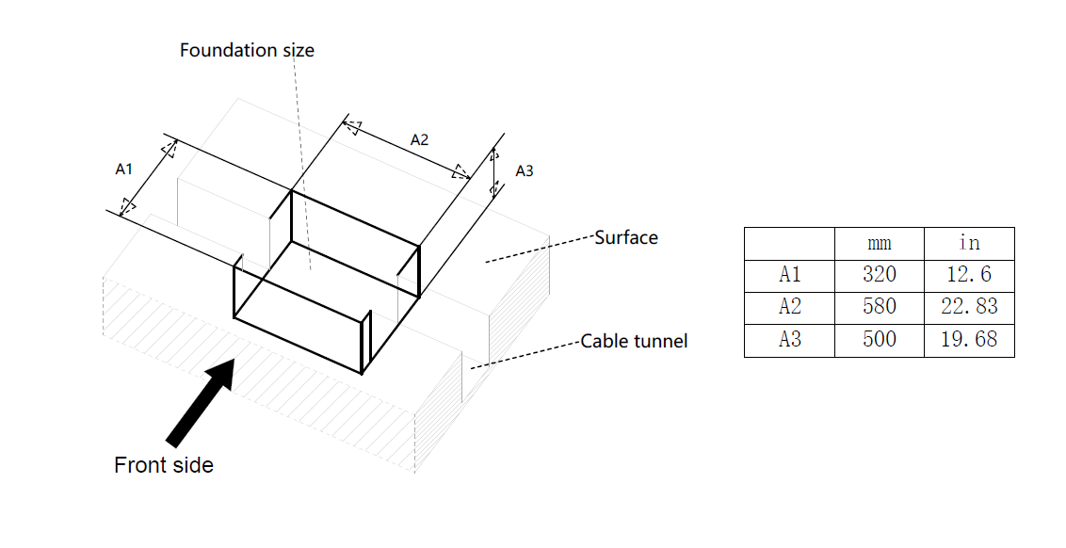
1. Dual Guns Charging Post foundation demension

Slide 3
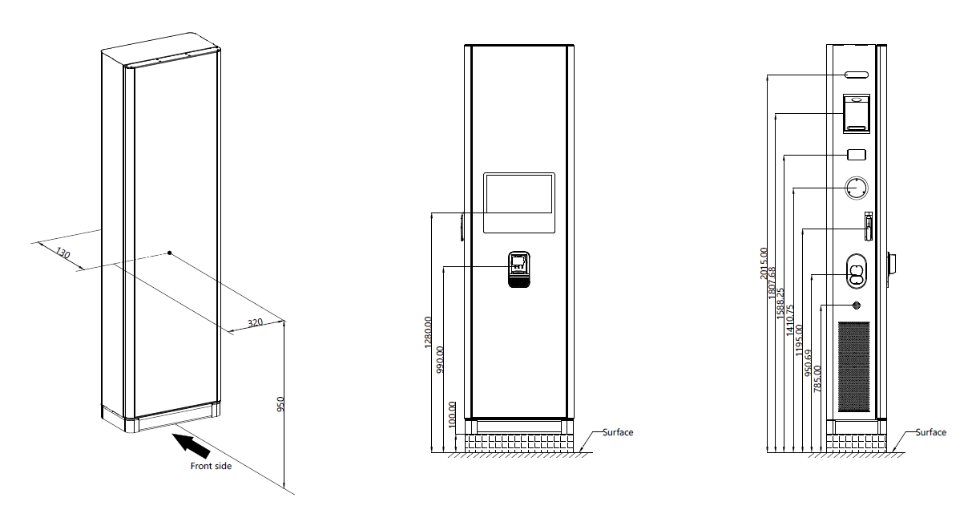
2. Dual Guns Charging post demension

Slide 4
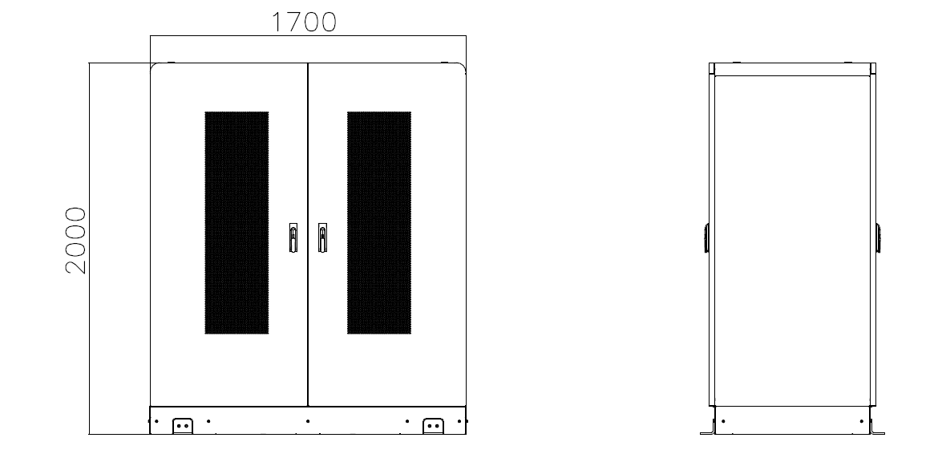
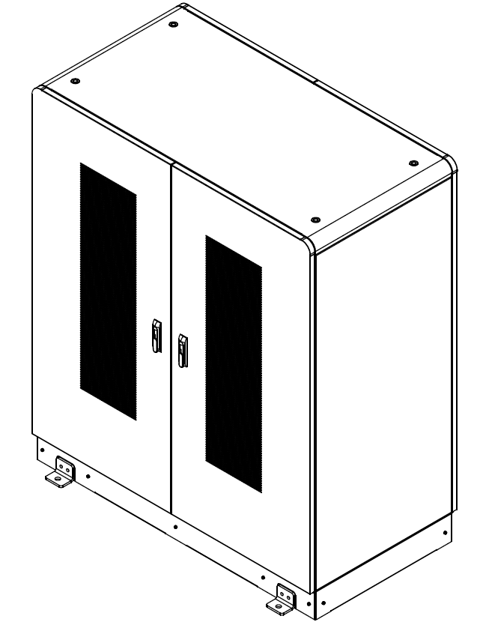
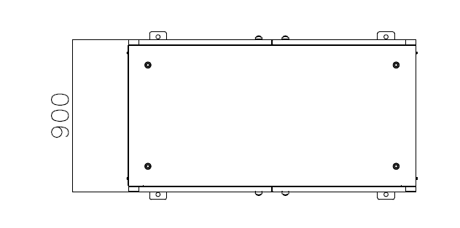
3. Power Cabinet demension

Slide 5
THANK YOU ！

